Slide 1
Pulham Market Traffic Monitoring
July – September 2026

Slide 2
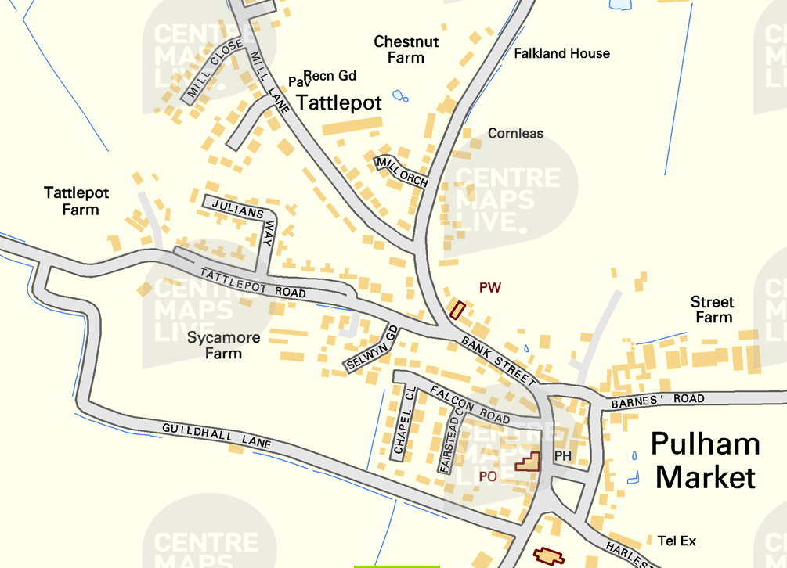
6th September 2026– Harleston Road heading into Pulham Market

Slide 3
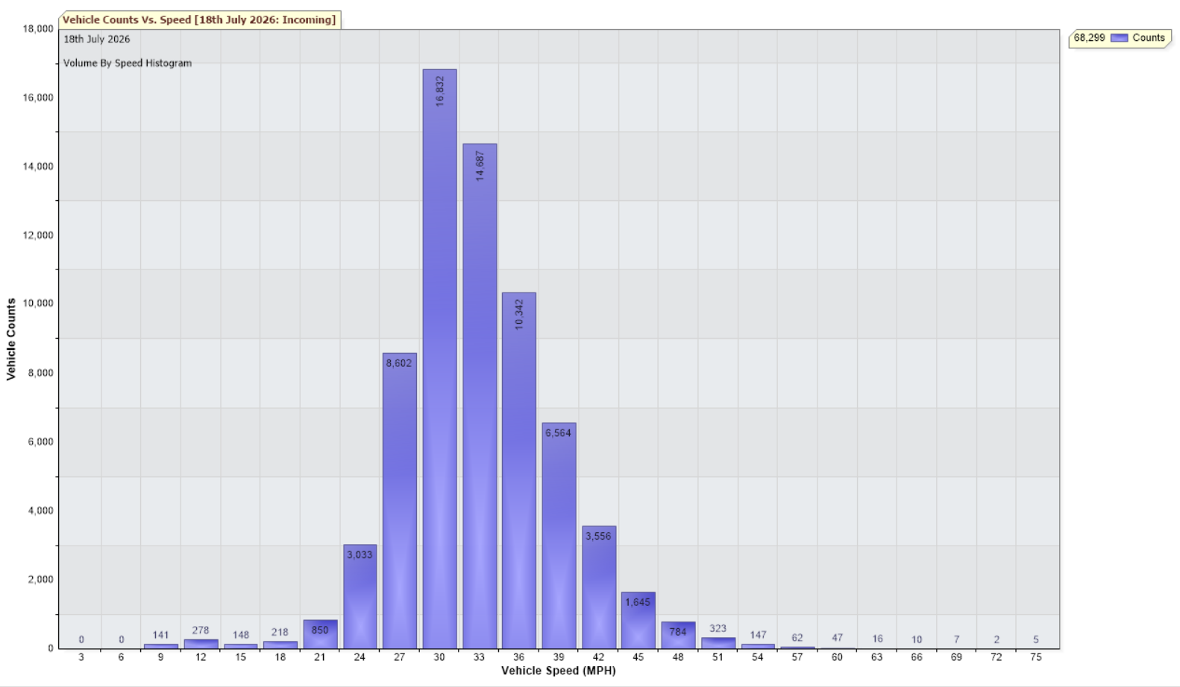
18th July – 6th September 2026 – Harleston Road heading to Pulham Market
85th Percentile 37.3 mph
Total Vehicles = 68299 counts
30MPH and Under (30102) = 44.07%
Over 30MPH (38197) = 55.93%

