Slide 1
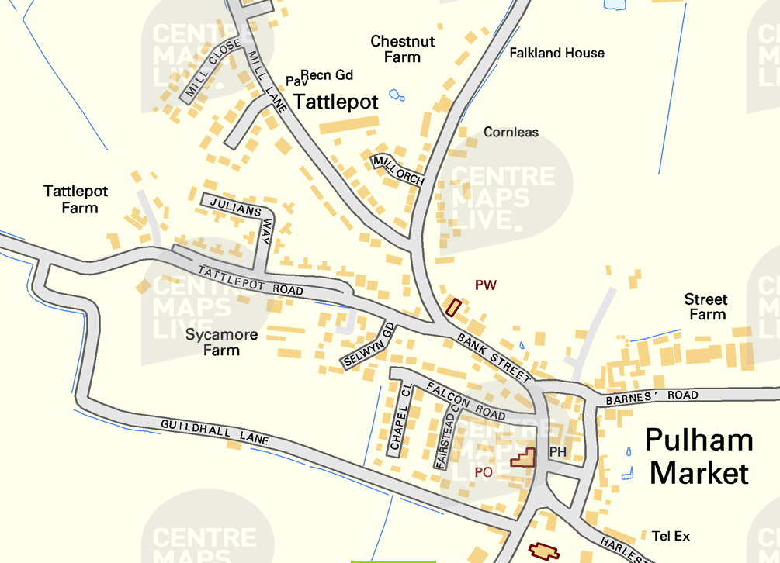
Pulham Market Traffic Monitoring
7th June 2026– Harleston Road heading into Pulham Market

Slide 2
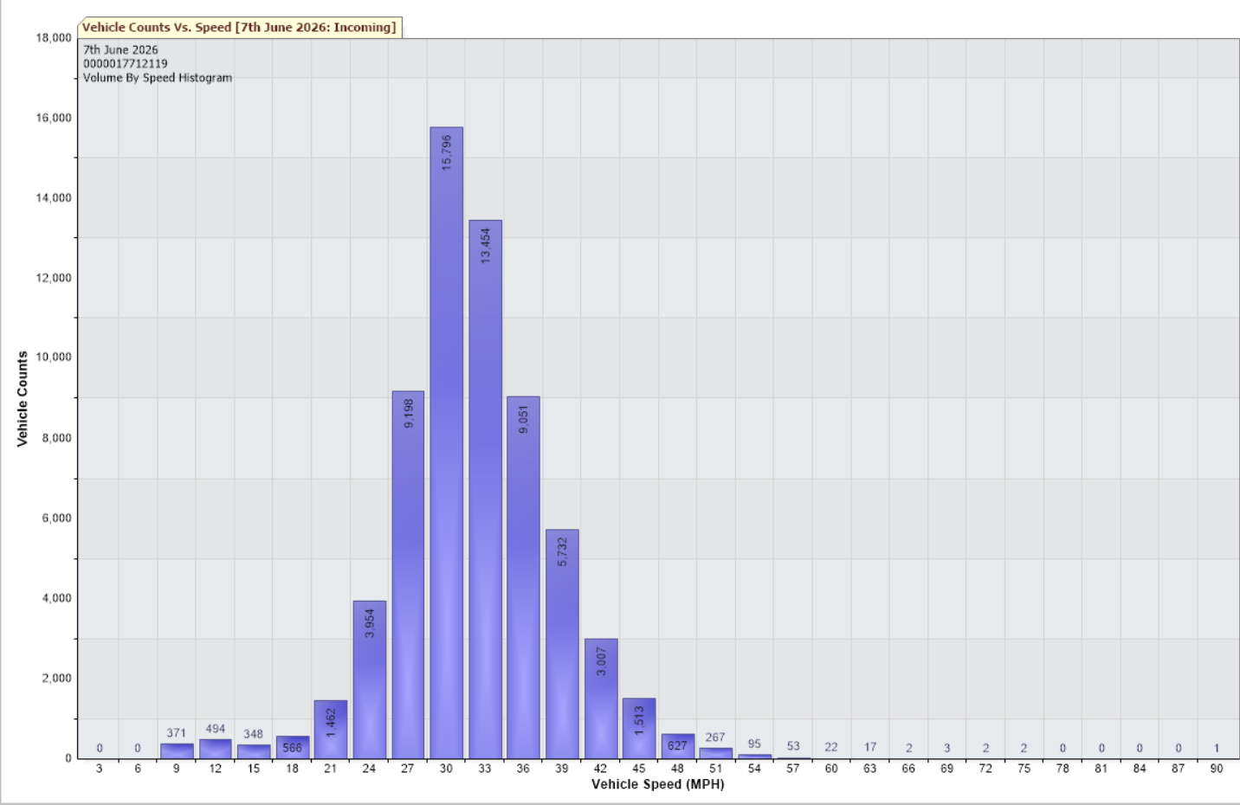
20th April – 7th June 2026 – Harleston Road heading to Pulham Market
85th Percentile 36.8mph
Total Vehicles = 66037 counts
30MPH and Under (16397) = 24.83%
Over 30MPH (49640) = 75.17%

