Slide 1
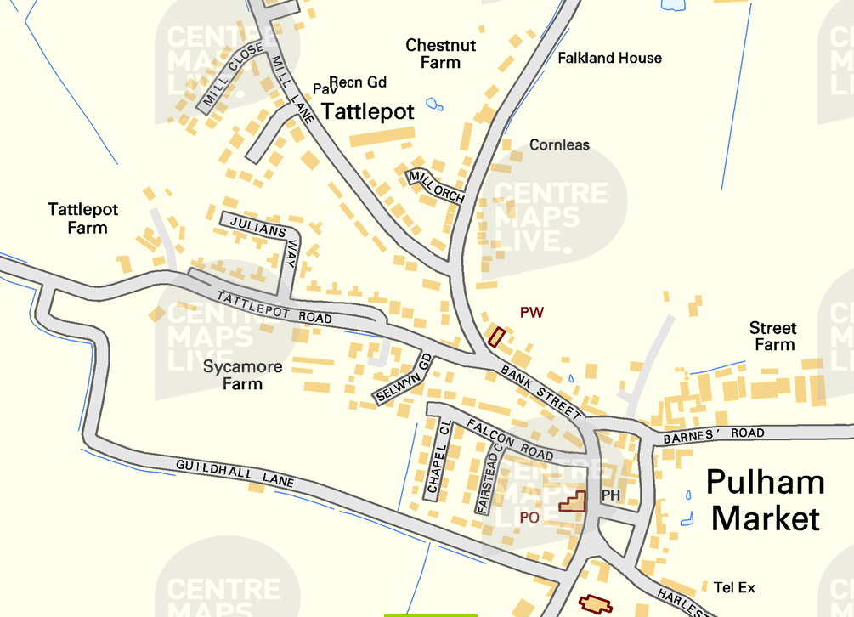
Pulham Market Traffic Monitoring
13th July 2026– Tattlepot Lane heading into Pulham Market

Slide 2
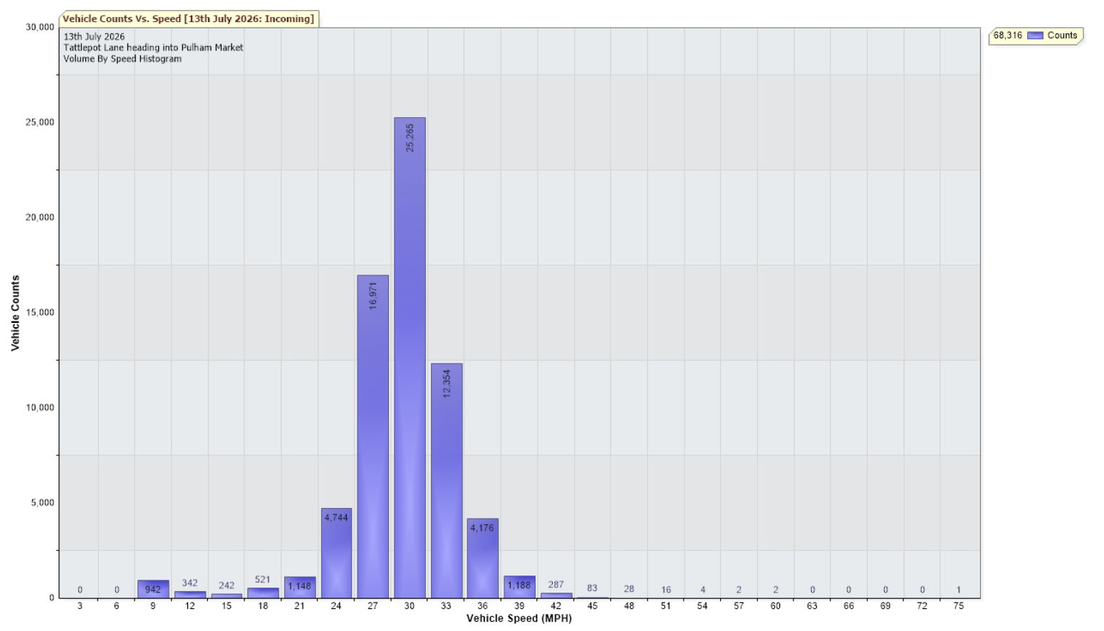
8th June – 13th July 2026 – Tattlepot Lane heading to Pulham Market
85th Percentile 31.9 mph
Total Vehicles = 68316 counts
30MPH and Under (24910) = 36.46%
Over 30MPH (43406) = 63.54%

