Slide 1
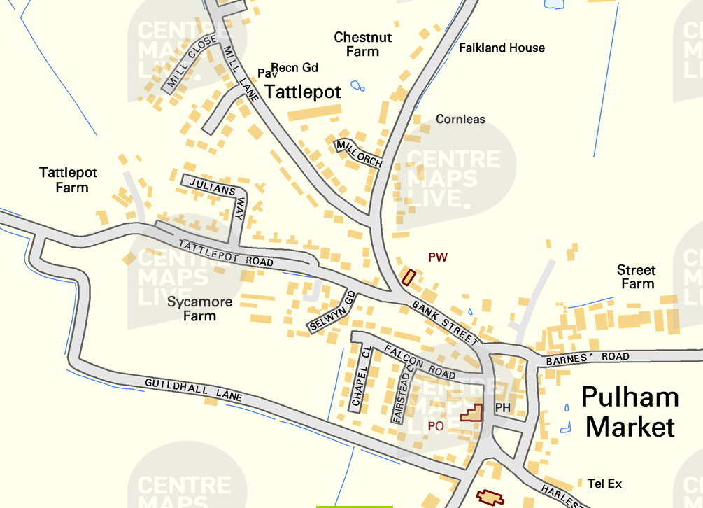
Pulham Market Traffic Monitoring
Nov/Dec 2025 – Harleston Rd heading into Pulham Market

Slide 2
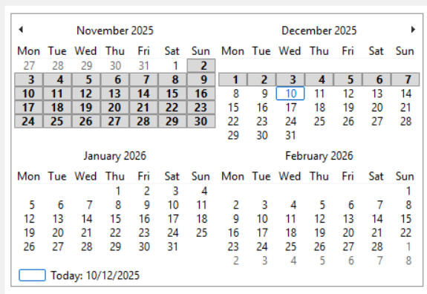

Slide 3
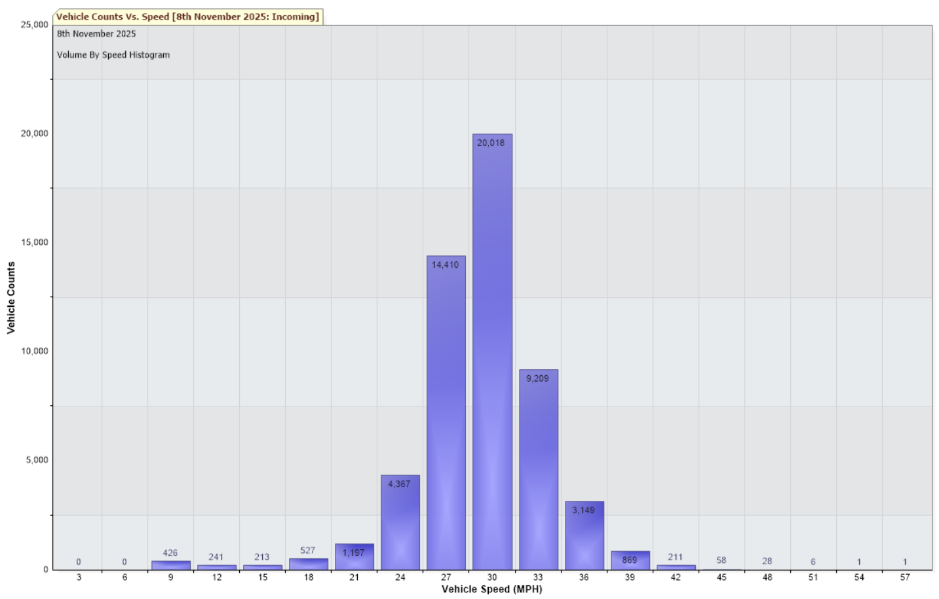
2nd November to 7th December 2025 – Harleston Road heading into Pulham Market
Traffic Report Max Speed = 66 MPH
Total Vehicles = 14025 counts
30MPH and Under (8183) = 58.35%
Over 30MPH (5842) = 41.65%

Slide 4
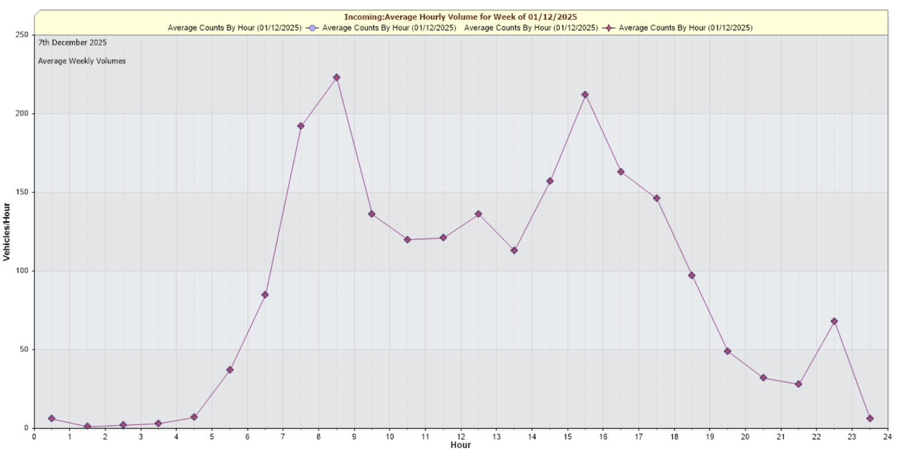
2nd November to 7th December 2025 – Harleston Road heading into Pulham Market
Traffic Report Max Speed = 66 MPH
Total Vehicles = 14025 counts

Slide 5
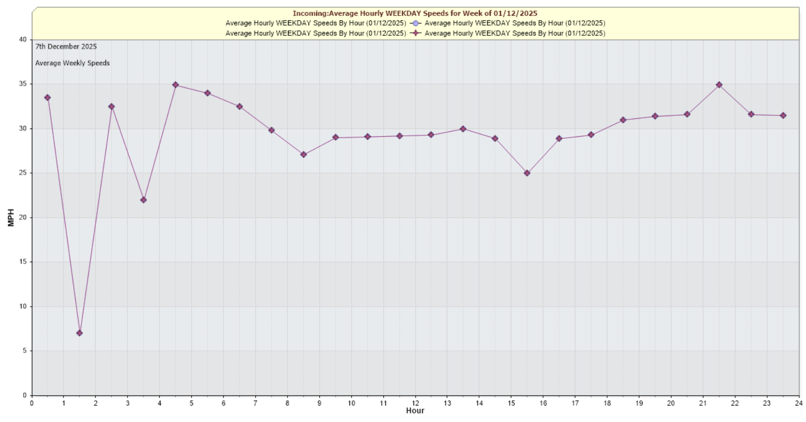
14th October to 9th November 2025 – Julians Way heading into Pulham Market
Traffic Report Max Speed = 57 MPH
Total Vehicles = 54931 counts

